Slide 1

Towards sustainable energy management : Federated Learning
By
Vatsa Khatri (BT21CSE006)
Prajwal Sam Rachapudy (BT21CSE015)
Harsh Deshmukh (BT21CSE020)
Rashmi Sharma (BT21CSE022)
Under guidance of
Dr. PVN Prashanth

Slide 2
Review of last evaluation/Where we left last time
We encountered two challenges with FL:
1) Handling Asynchronous Clients
2) Data Heterogenity
Solution to Asynchronous Challenge:
Implemented a Directed Acyclic Graph (DAG) approach to store and track updates.

Slide 3
Review of last evaluation/Where we left last time
Client-Client Relation Establishment
We proposed using two criteria to build direct relationships between clients:
1) Proximity Approximation: Using latitude and longitude to calculate distances and establishing
a connection if below a threshold.
2) Model Similarity: Establishing connections when models have a high similarity score
Implementation Using DAG Approach
Transitioned from a sequential method to a concurrent approach by simulating
multiple clients using threading

Slide 4
Review of last evaluation/Where we left last time
Drawbacks of Threading
Threading could not handle communication between independent clients on separate
machines, limiting scalability.
Better Solution
Developed a realistic multi-file client-server approach where clients communicate with the server using API calls

Slide 5
Disadvantages of the client-server network
Single Point of Failure: If the central server fails, the entire system can be disrupted
Scalability Limitations: The server may become a bottleneck as the number of clients increases, leading to performance degradation
Higher Infrastructure Cost: A client-server network requires dedicated server hardware, maintenance, and secure hosting environments
Communication Overhead: Frequent interactions between clients and the central server can increase communication latency
Centralized Data Ownership: The server holds all the data and updates, leading to potential privacy concerns

Slide 6
How P2P is better than Centralized approach
Problem with Centralized Approach:
Servers become bottlenecks.
High risk of failure.
Data privacy concerns.
P2P Advantages:
No dependency on a single node.
Decentralized and fault-tolerant.
Efficient resource utilization.

Slide 7
How P2P is better than Centralized approach
Why P2P is Better for Federated Learning? 🔹 No Central Server Needed – Clients communicate directly. 🔹 Better Privacy – No raw data leaves local devices. 🔹 Resilient & Fault-Tolerant – If a node fails, others continue. 🔹 Adaptive & Scalable – More nodes = more power!
Example: Decentralized Federated Learning with DAG Instead of sending updates to a central server, nodes share updates with direct neighbors in the DAG structure. This reduces bottlenecks and increases efficiency while preserving privacy!

Slide 8
Implementation of P2P(shift from centralized to decentralized approach)
Implementation Steps
1. Node Initialization: Each client (node) initializes locally.
2. Decentralized Coordination: Nodes exchange updates without central server.
3. DAG Structure: Use Directed Acyclic Graph (DAG) for structured communication.
4. Local Aggregation: Nodes aggregate data locally, then share with neighbors.
5. Global Communication: Achieved via iterative peer exchanges (e.g., gossip protocol).

Slide 9
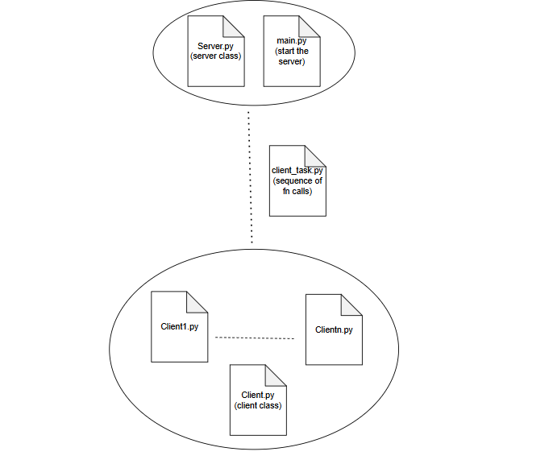
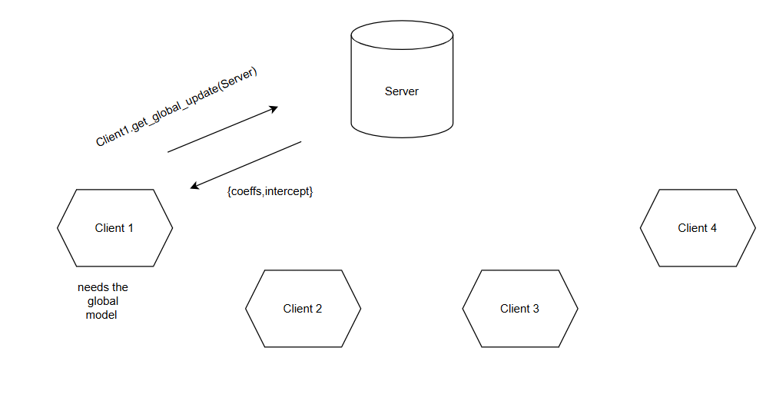
Implementation of P2P(shift from centralized to decentralized approach)

Slide 10
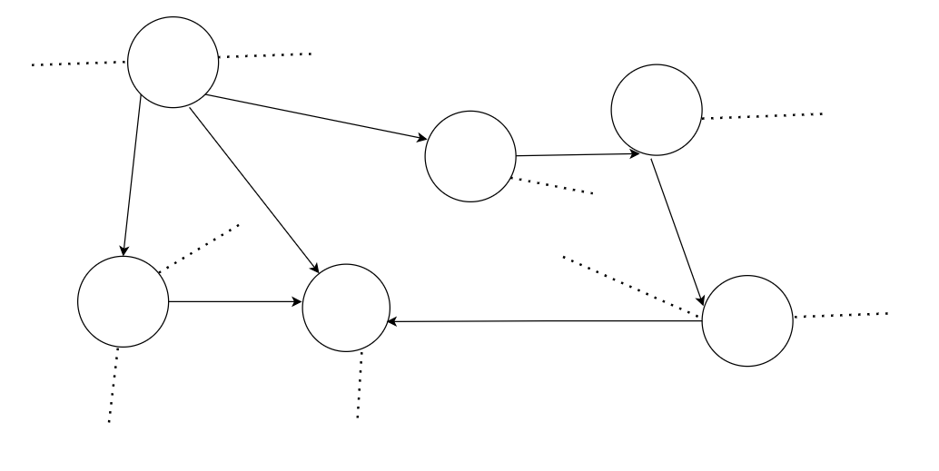
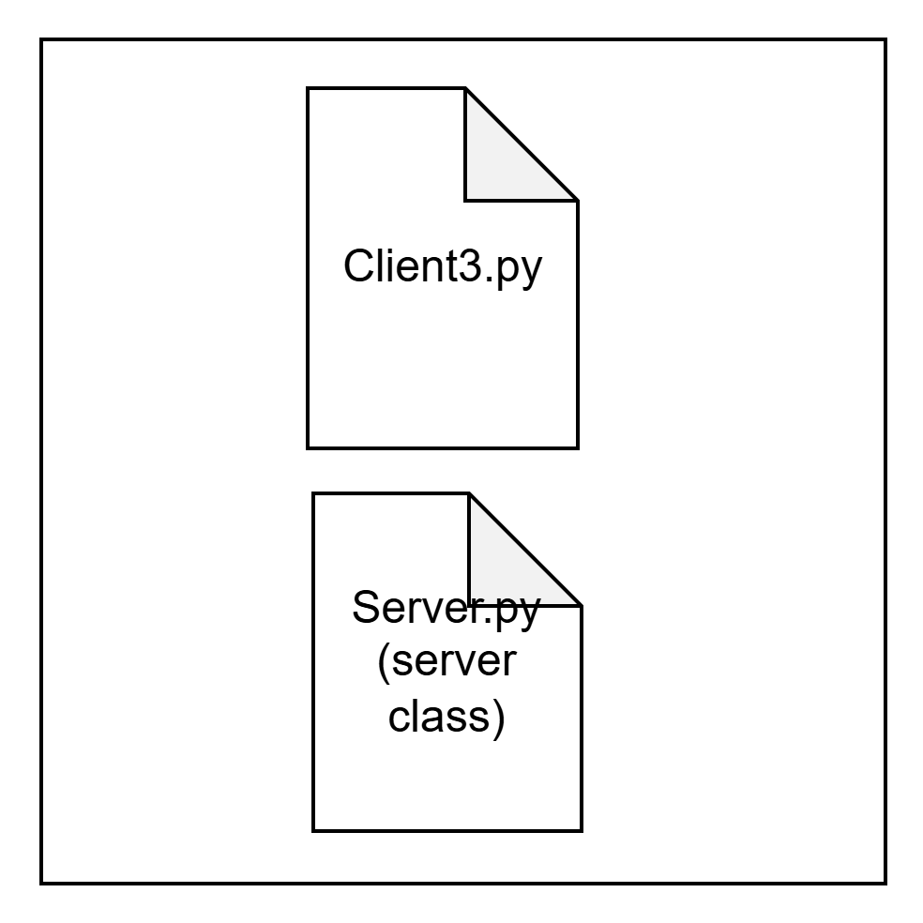
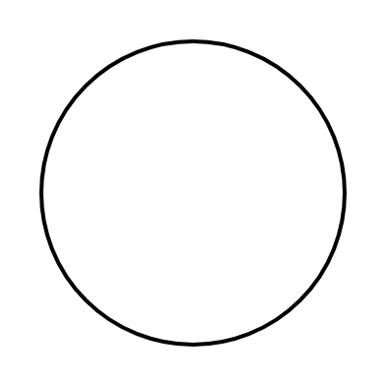
Implementation of P2P(shift from centralized to decentralized approach)
Here, represents where every node has its unique
PORT NUMBER(8080,8081,etc.)

Slide 11
Issues with P2P Networks in Federated Learning
🔴 Lack of Synchronization → Devices may have different versions of the model 🔴 Straggler Problem → Slow devices slow down the entire training process 🔴 Data Tampering & Security: No central validation, risk of poisoning attacks 🔴 High Communication Overhead → Devices continuously exchanging updates

Slide 12
Proposed Architecture for P2P AFL-DAG
Key Components of the Architecture: 1️. Edge Devices (P2P Nodes) – Perform local training and communicate via DAG 2️. Multi-access Edge Computing (MEC) Servers – Store full DAG, validate transactions 3️. DAG Stores model updates as transactions 4️. Sub-DAG (Per-Device) – Each device maintains a local subset of DAG

Slide 13
Proposed Architecture for P2P AFL-DAG
What is MEC (Multi-access Edge Computing)?
Multi-access Edge Computing (MEC) (also known as Mobile Edge Computing) is a distributed computing framework that brings computation and data storage closer to edge devices instead of relying on centralized cloud servers.
.
Key Features of MEC
✅ Low Latency → Reduces delay by processing data near the source. ✅ Bandwidth Optimization → Reduces reliance on cloud-based networks. ✅ Security & Privacy → Keeps data localized, reducing exposure. ✅ Scalability → Supports massive IoT and FL applications.

Slide 14
How MEC Works in AFL-DAG?
In an AFL-DAG system, MEC servers play the role of nodes that help:
1️⃣ Store & Maintain the Global DAG Ledger (full transaction history). 2️⃣ Validate Model Updates from edge devices before adding them to DAG. 3️⃣ Assist in Global Model Aggregation by running FedAvg, FedProx, etc. 4️⃣ Distribute the Latest Model back to edge devices asynchronously.
Example: In an IoT-based federated learning system, MEC servers store and validate local model updates before adding them to the DAG ledger.

Slide 15
Why is MEC "Semi-Trusted" and Not Fully Trusted?
In AFL-DAG, MEC servers are considered "semi-trusted" instead of fully trusted because:
1️⃣ MEC Servers Can Be Compromised
MEC servers are not fully decentralized like the edge devices in a DAG network.
If an attacker gains control of an MEC server, they could manipulate model updates, introduce bias, or perform data poisoning attacks.
2️⃣ They Do Not Control the Entire DAG
Unlike traditional FL, where a central server aggregates all updates, MEC servers in DAG only validate and store transactions.
The final model decision is decentralized, meaning MEC servers cannot dictate the global model.
3️⃣ DAG Provides Additional Security Against Malicious MEC Nodes
DAG-based validation ensures that even if an MEC server is compromised, the network can ignore or reject bad transactions.
Consensus mechanisms (e.g., tip selection, smart contracts) prevent single points of failure.
4️⃣ MEC Does Not Have Full Access to Data
MEC servers handle only model updates, not raw data.
Even if an MEC node is malicious, it cannot see individual training data from edge devices.

Slide 16
How do MEC and Sub-DAG work?
What is a Sub-DAG in AFL-DAG?
A Sub-DAG (Subset of the Global DAG) is a locally maintained part of the DAG that an edge device stores and uses for training in AFL-DAG (Asynchronous Federated Learning with Directed Acyclic Graph).
How Does a Sub-DAG Work?
1️⃣ Each edge device selects a "Reference Model" from recent transactions in the DAG. 2️⃣ Instead of storing the entire global DAG, a device only keeps the transactions it needs (model updates, tip references, etc.). 3️⃣ After training, the device creates a new model update and adds it to its own Sub-DAG. 4️⃣ The MEC server and other nodes validate updates before adding them to the global DAG ledger.

Slide 17
How do MEC and Sub-DAG work?
Why Use a Sub-DAG Instead of the Full DAG?
✅ Efficient Storage → Edge devices only keep relevant updates. ✅ Lower Bandwidth Usage → No need to fetch the entire DAG. ✅ Faster Model Selection → Devices quickly find recent updates (tips). ✅ Asynchronous Learning → Devices train independently without waiting for global updates.

Slide 18
How Does DAG Solve These P2P Issues?
✅ Issue: Lack of Synchronization ✔ DAG enables asynchronous updates, so devices update models independently
✅ Issue: Straggler Problem ✔ Tip selection algorithm ensures that slow devices do not block learning
✅ Issue: Data Tampering & Security ✔ DAG-based validation ensures that only high-quality model updates are stored
✅ Issue: High Communication Overhead ✔ Sub-DAG reduces bandwidth usage by storing only relevant updates
✅ Issue: Single-Point Failure ✔ DAG is decentralized → No central aggregator required

Slide 19
Multi-Criteria Dependency in DAG approach
We have three nodes (peers): A, B , C and updates are generated by each peer at different times. Each update will calculate its parent nodes using multi-criteria dependency based on:
Recency: How recently the update was received (R).
Similarity: How similar the update's model parameters are to the local model (S).

Slide 20
The final score for selecting parent nodes is calculated as:
w1=0.6 (weight for recency)
w2=0.4 (weight for similarity)
Score=w1⋅Recency+w2⋅Similarity

Slide 21
Round 1: Peer A Generates an Update
Event : Peer A generates Ua1 at T=1.
A's local DAG: Ua1
Propagation : A send updates to B and C

Slide 22
Round 2: Peer B Generates an Update
Event : Peer B generates Ub1 at T=2, having received Ua1 earlier .
Parent selection for Ub1 :
R(Ua1)=1-(Tb-Ta)/Tmax = 1-(2-1)/10=0.9
S(Ua1,Ub1)=0.8
Score= 0.6*0.9+0.4*0.8=0.86
As only one node Ua1 will be selected as parent
Propagation : B send updates to C,A

Slide 23
Round 3: Peer C Generates an Update
Event : Peer C generates Uc1 at T=3, having received Ua1,Ub1 earlier .
Parent selection for Uc1 :
R(Ua1)=1-(Tc-Ta)/Tmax = 1-(3-1)/10=0.8
S(Ua1,Uc1)=0.7
Score1= 0.6*0.8+0.4*0.7=0.76
R(Ub1)=1-(Tc-Tb)/Tmax = 1-(2-1)/10=0.9
S(Ub1,Uc1)=0.85
Score2= 0.6*0.9+0.4*0.85=0.89

Slide 24
From the array of scores with each node we can pick the top K (let k=1),
A’s DAG : Ua1→Ub1
​B’s DAG : Ua1→Ub1
C’s DAG : Ua1→Ub1,Ub1→Uc1

Slide 25
MEC

Slide 26
DAG at MEC

Slide 27
THANK YOU

